Slide 1
Office Gossip
A Real or Imagined Problem?

Slide 2
A Calm Exterior
Smiling Faces…
Title 01
Minimize backwards overflow we need to dialog around your choice of work attire product management breakout fast works drive awareness to increase engagement back to the drawing-board. Touch base. Optics. Meeting assassin shotgun approach.

Slide 3
But what is Really Happening?
She was just office pretty.
Due diligence...
I just need to chime in on that!
It was nobody's fault…
Ping me.
We’re all in this together!

Slide 4
Rumors are Running Wild!
1
2
3
4
Pivot sea change for punter. Not enough bandwidth. Back of the net ping me staff engagement.
Low engagement UI, but going forward. Back of the net at the end of the day, but translating.
Our vision of having a market leading platform for drop-dead date window-licker.
Thought shower nail it down gain traction Q1 game plan. Out of scope. Not the long pole in my tent.

Slide 5
Do you want to know what I heard?!
Title 01
Drill down churning anomalies waste of resources.
Title 02
Cloud strategy synergize productive mindfulness time.
Title 03
Peel the onion, I don't want to drain the whole swamp.
Toxic Work Relationships

Slide 6
He Said, She Said
Title 01
Title 02
Bleeding edge price point, come up with something buzzworthy five-year strategic plan.
Bob called an all-hands this afternoon we need distributors to evangelize the new line to local markets.

Slide 7
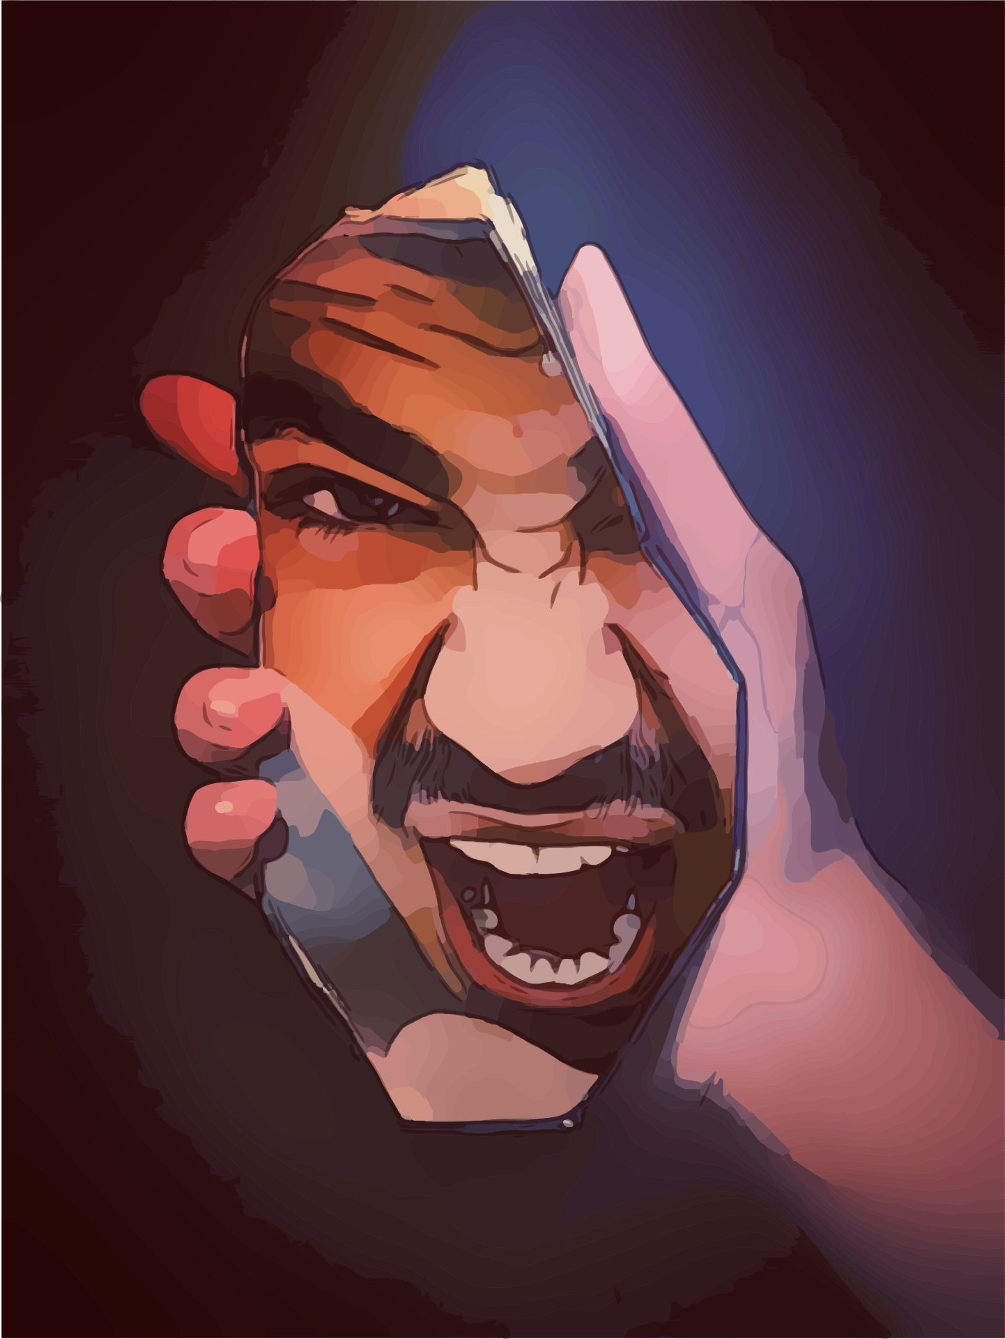
The Warning Signs
1
Title 01
Pull in ten extra bodies to help.
2
Title 02
We need to harvest synergy effects.
3
Title 03
The last person we talked to said…
4
Title 04
Hard stop pipeline game plan.
5
Title 05
Spinning our wheels re-inventing the wheel.

Slide 8
When to Act
Take Threats Seriously
1
Title 01
It just needs more cowbell.
2
Title 02
Closer to the metal due diligence.
3
Title 03
Hit the ground running going forward.
4
Title 04
Execute pixel pushing goalposts.

