Slide 1

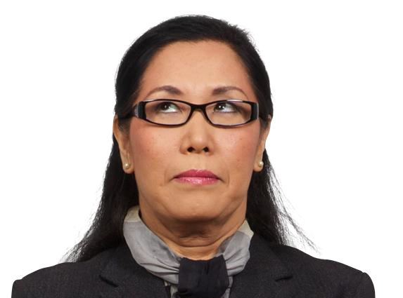



How to Create Cartoons Using Powerpoint
By Tracy Carroll
Cool,
I guess.
Notes:
Hello, welcome to How to Create Cartoons in PowerPoint. Actually, there are a lot of ways to create cartoons, and this is just one simple way that I use a lot.

Slide 2
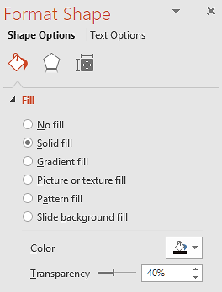
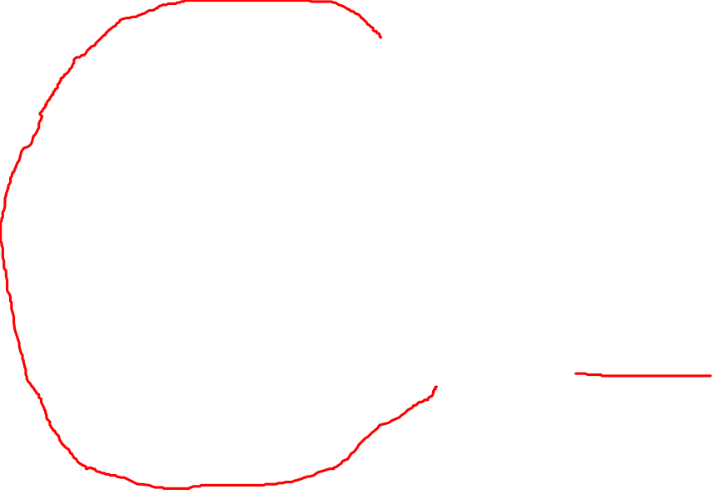
How to Create Cartoons Using Powerpoint
Hair
Semi-transparent black oval
Cool,
I guess.
Notes:
I use an image as my guide, and I cover the image with PowerPoint shapes to simulate the underlying image. While I’m working, I keep the shapes transparent, so I can see what is underneath. Here, I’ve layered a black semi-transparent oval shape that will represent the top of her hair.

Slide 3
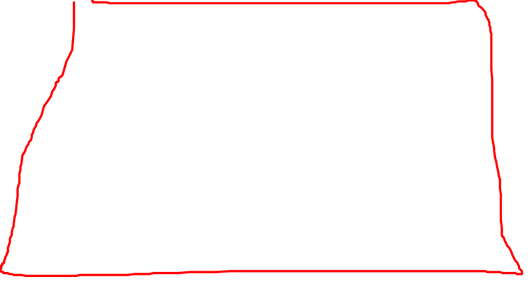
How to Create Cartoons Using Powerpoint
Hair
Semi-transparent black trapezoid
Cool,
I guess.
Notes:
For the bottom of her hair, I’ll use a trapezoid shape.

Slide 4
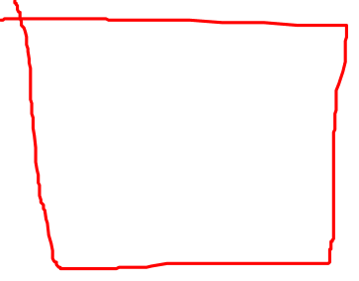
How to Create Cartoons Using Powerpoint
Neck
Semi-transparent rectangle
Cool,
I guess.
Notes:
A rectangle shape will become the neck.

Slide 5
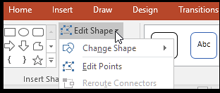
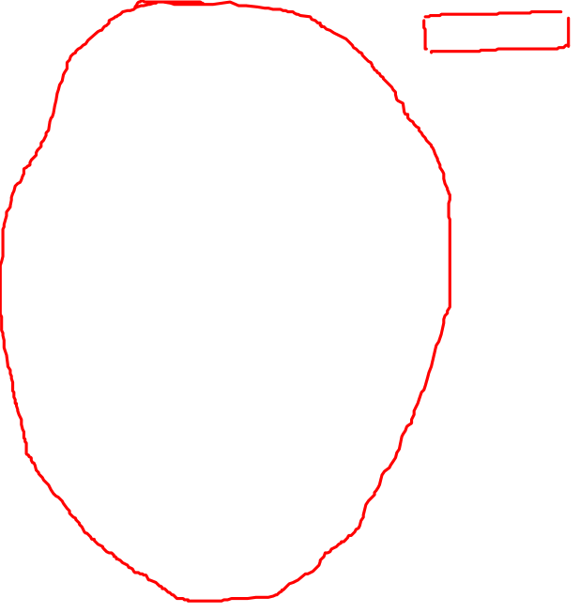
How to Create Cartoons Using Powerpoint
Face
Semi-transparent oval
*Use Edit Points to adjust
Cool,
I guess.
Notes:
For her face, I’ll use an oval shape. To adjust the shape to be closer to the underlying image, I’ll use the Edit Points tool.

Slide 6
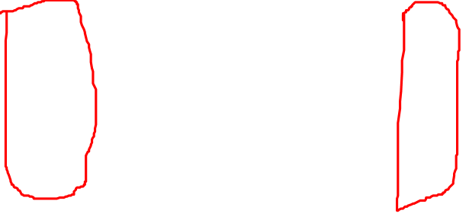
How to Create Cartoons Using Powerpoint
Ears
Semi-transparent ovals
*Use Edit Points to adjust
Cool,
I guess.
Notes:
For the ears, I’ll use more oval shapes, and I used the Edit Points tool to sort of squash them into ear shapes.

Slide 7
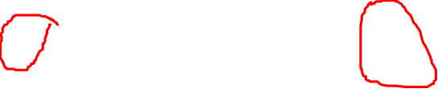
How to Create Cartoons Using Powerpoint
Earrings
Ovals
Cool,
I guess.
Notes:
The earrings are simple oval shapes.

Slide 8
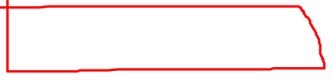
How to Create Cartoons Using Powerpoint
Eyebrows
Moon shapes
*Use Edit Points to adjust
Cool,
I guess.
Notes:
Eyebrows are moon shapes, adjusted with the Edit Points tool.

Slide 9
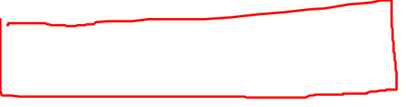
How to Create Cartoons Using Powerpoint
Eyeglasses
Rounded rectangles & trapezoids
*Use Edit Points to adjust
Cool,
I guess.
Notes:
Eyeglasses are created using rounded rectangles and trapezoids, adjusted with the Edit Points tool.

Slide 10
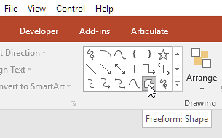
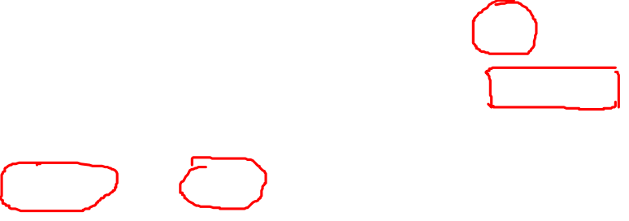
How to Create Cartoons Using Powerpoint
Eyes
Freeform shapes
*Use Edit Points to adjust
Cool,
I guess.
Notes:
The eyes were created by drawing the shapes using the Freeform shapes tool.

Slide 11

How to Create Cartoons Using Powerpoint
Irises
Ovals
*Use Edit Points to adjust
Cool,
I guess.
Notes:
The irises are black ovals.

Slide 12
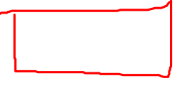
How to Create Cartoons Using Powerpoint
Lips
Freeform shape
*Use Edit Points to adjust
Cool,
I guess.
Notes:
Lips were drawn with the Freeform Shape tool.

Slide 13
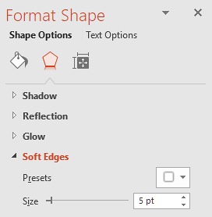
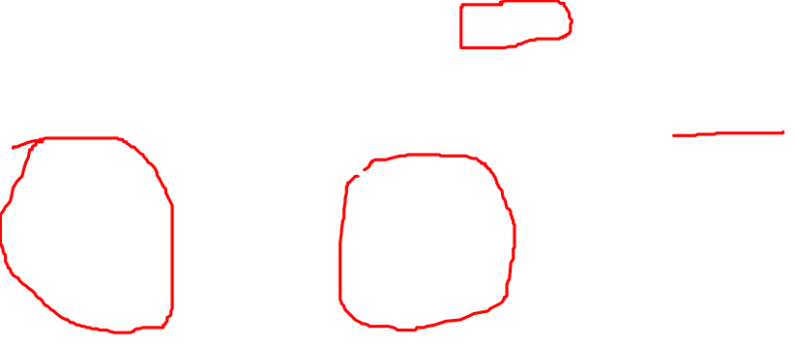
How to Create Cartoons Using Powerpoint
Cheeks
Ovals
*Use Edit Points to adjust, use Soft Edges tool
Cool,
I guess.
Notes:
The cheek color was created with ovals, and adjusted with the Edit Points tool. I used the Soft Edges tool to make the cheek color easier to blend in with the face oval.

Slide 14
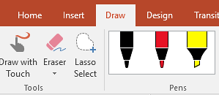
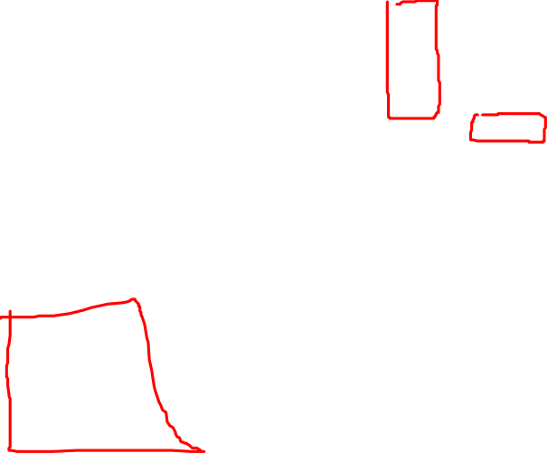
How to Create Cartoons Using Powerpoint
Nose
Draw
*Use Pen tool
Cool,
I guess.
Notes:
I drew the nose using the Pen tool. This is where using transparent shapes comes in handy. I outlined the nose by following the lines of the underlying image.

Slide 15
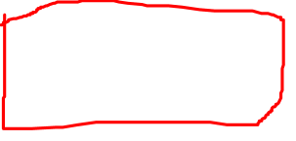
How to Create Cartoons Using Powerpoint
Mouth outline
Draw
*Use Pen tool
Cool,
I guess.
Notes:
I outlined the mouth, and her expression lines, using the Pen tool, as well.

Slide 16
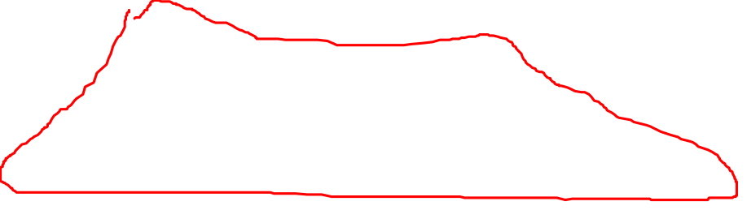
How to Create Cartoons Using Powerpoint
Scarf, jacket
Freeform shapes
*Use Edit Points to adjust
Cool,
I guess.
Notes:
The scarf and jacket were created by using Freeform shapes.

Slide 17
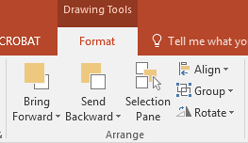
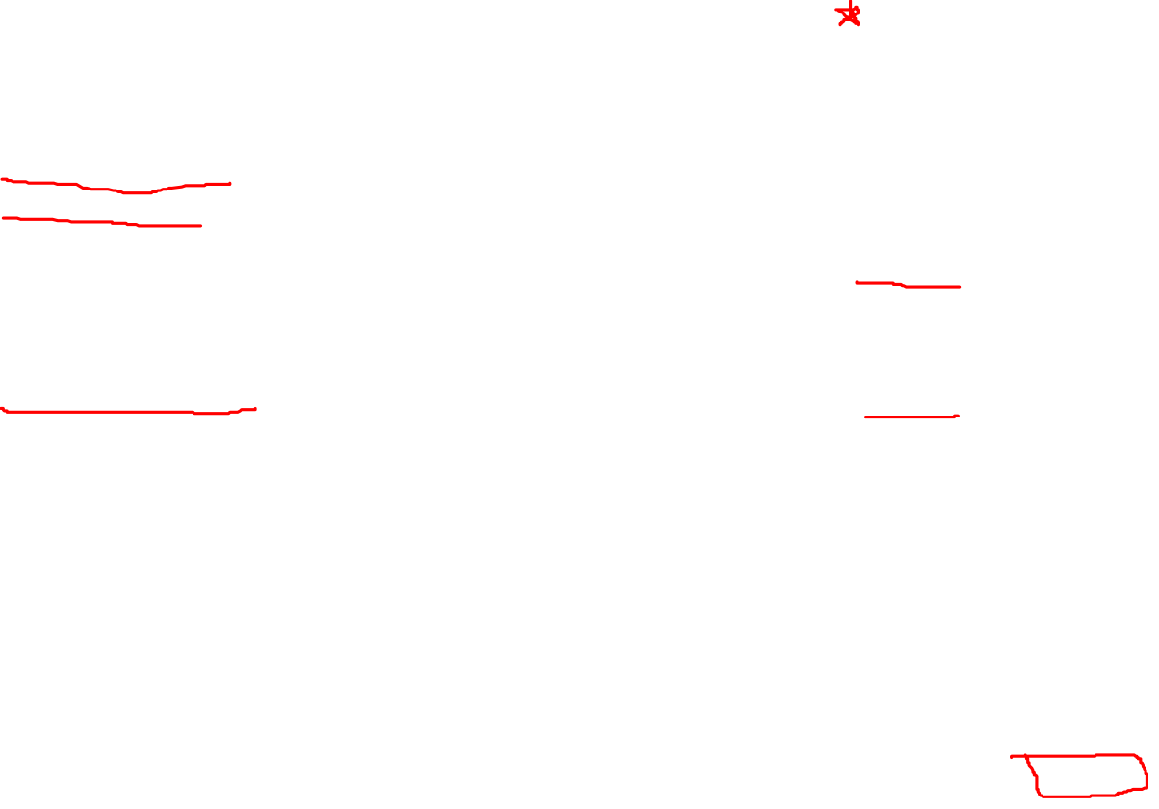
How to Create Cartoons Using Powerpoint
Cool,
I guess.
*Delete the underlying image.
Select all the remaining shapes, and Group them. You can now save the image as a picture, if desired.
Adjust transparency of the shapes: reduce to 0% transparency for everything except the cheek color.
Cheek color is 88% transparent.
Notes:
At this point, I’ve created all the shapes I need, so I reduce the transparency of the shapes to zero percent—except for the cheek color. I want the cheek color to be subtle, so I’ve set it at 88% transparent. I deleted the underlying image, so all I have left are the shapes and the ink drawing that make up my cartoon. You can select all the shapes and Group them now. If you want to save the grouped shapes as an image, right-click and choose Save as a Picture.

Slide 18

How to Create Cartoons Using Powerpoint
Cool,
I guess.
Original image
Notes:
I’ve added a Shadow effect to the cartoon, and a callout. And this is the finished cartoon!

